Slide 1

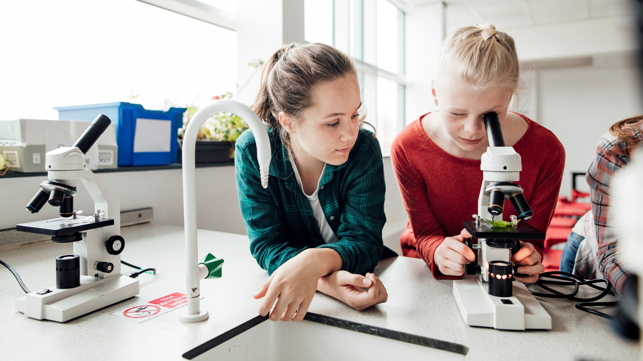
Poinciana High School
9th / 10th Grades Reading Test Family night

Slide 2



Testing Expectations
FAST Reading
Progress Monitoring (PM1) = September
Final Test (PM3) = May
Progress Monitoring (PM2) = December

Slide 3
WHY is this assessment important?
Students take this assessment for many reasons. Some include:
Helps teachers identify and meet the needs of all students
Course placement (allows students to take certain classes at certain times and skip out of other classes in favor of electives)
State of Florida graduation requirement
This year we have incentives (prizes) for students who become proficient (move from level 1 or 2 to a 3 or higher) and / or grow

Slide 4
FAST Test dates
PM2: Dec 2nd – 20th
FAST Writing: March 31st – April 4th
PM3: May 1st – 23rd

Slide 5
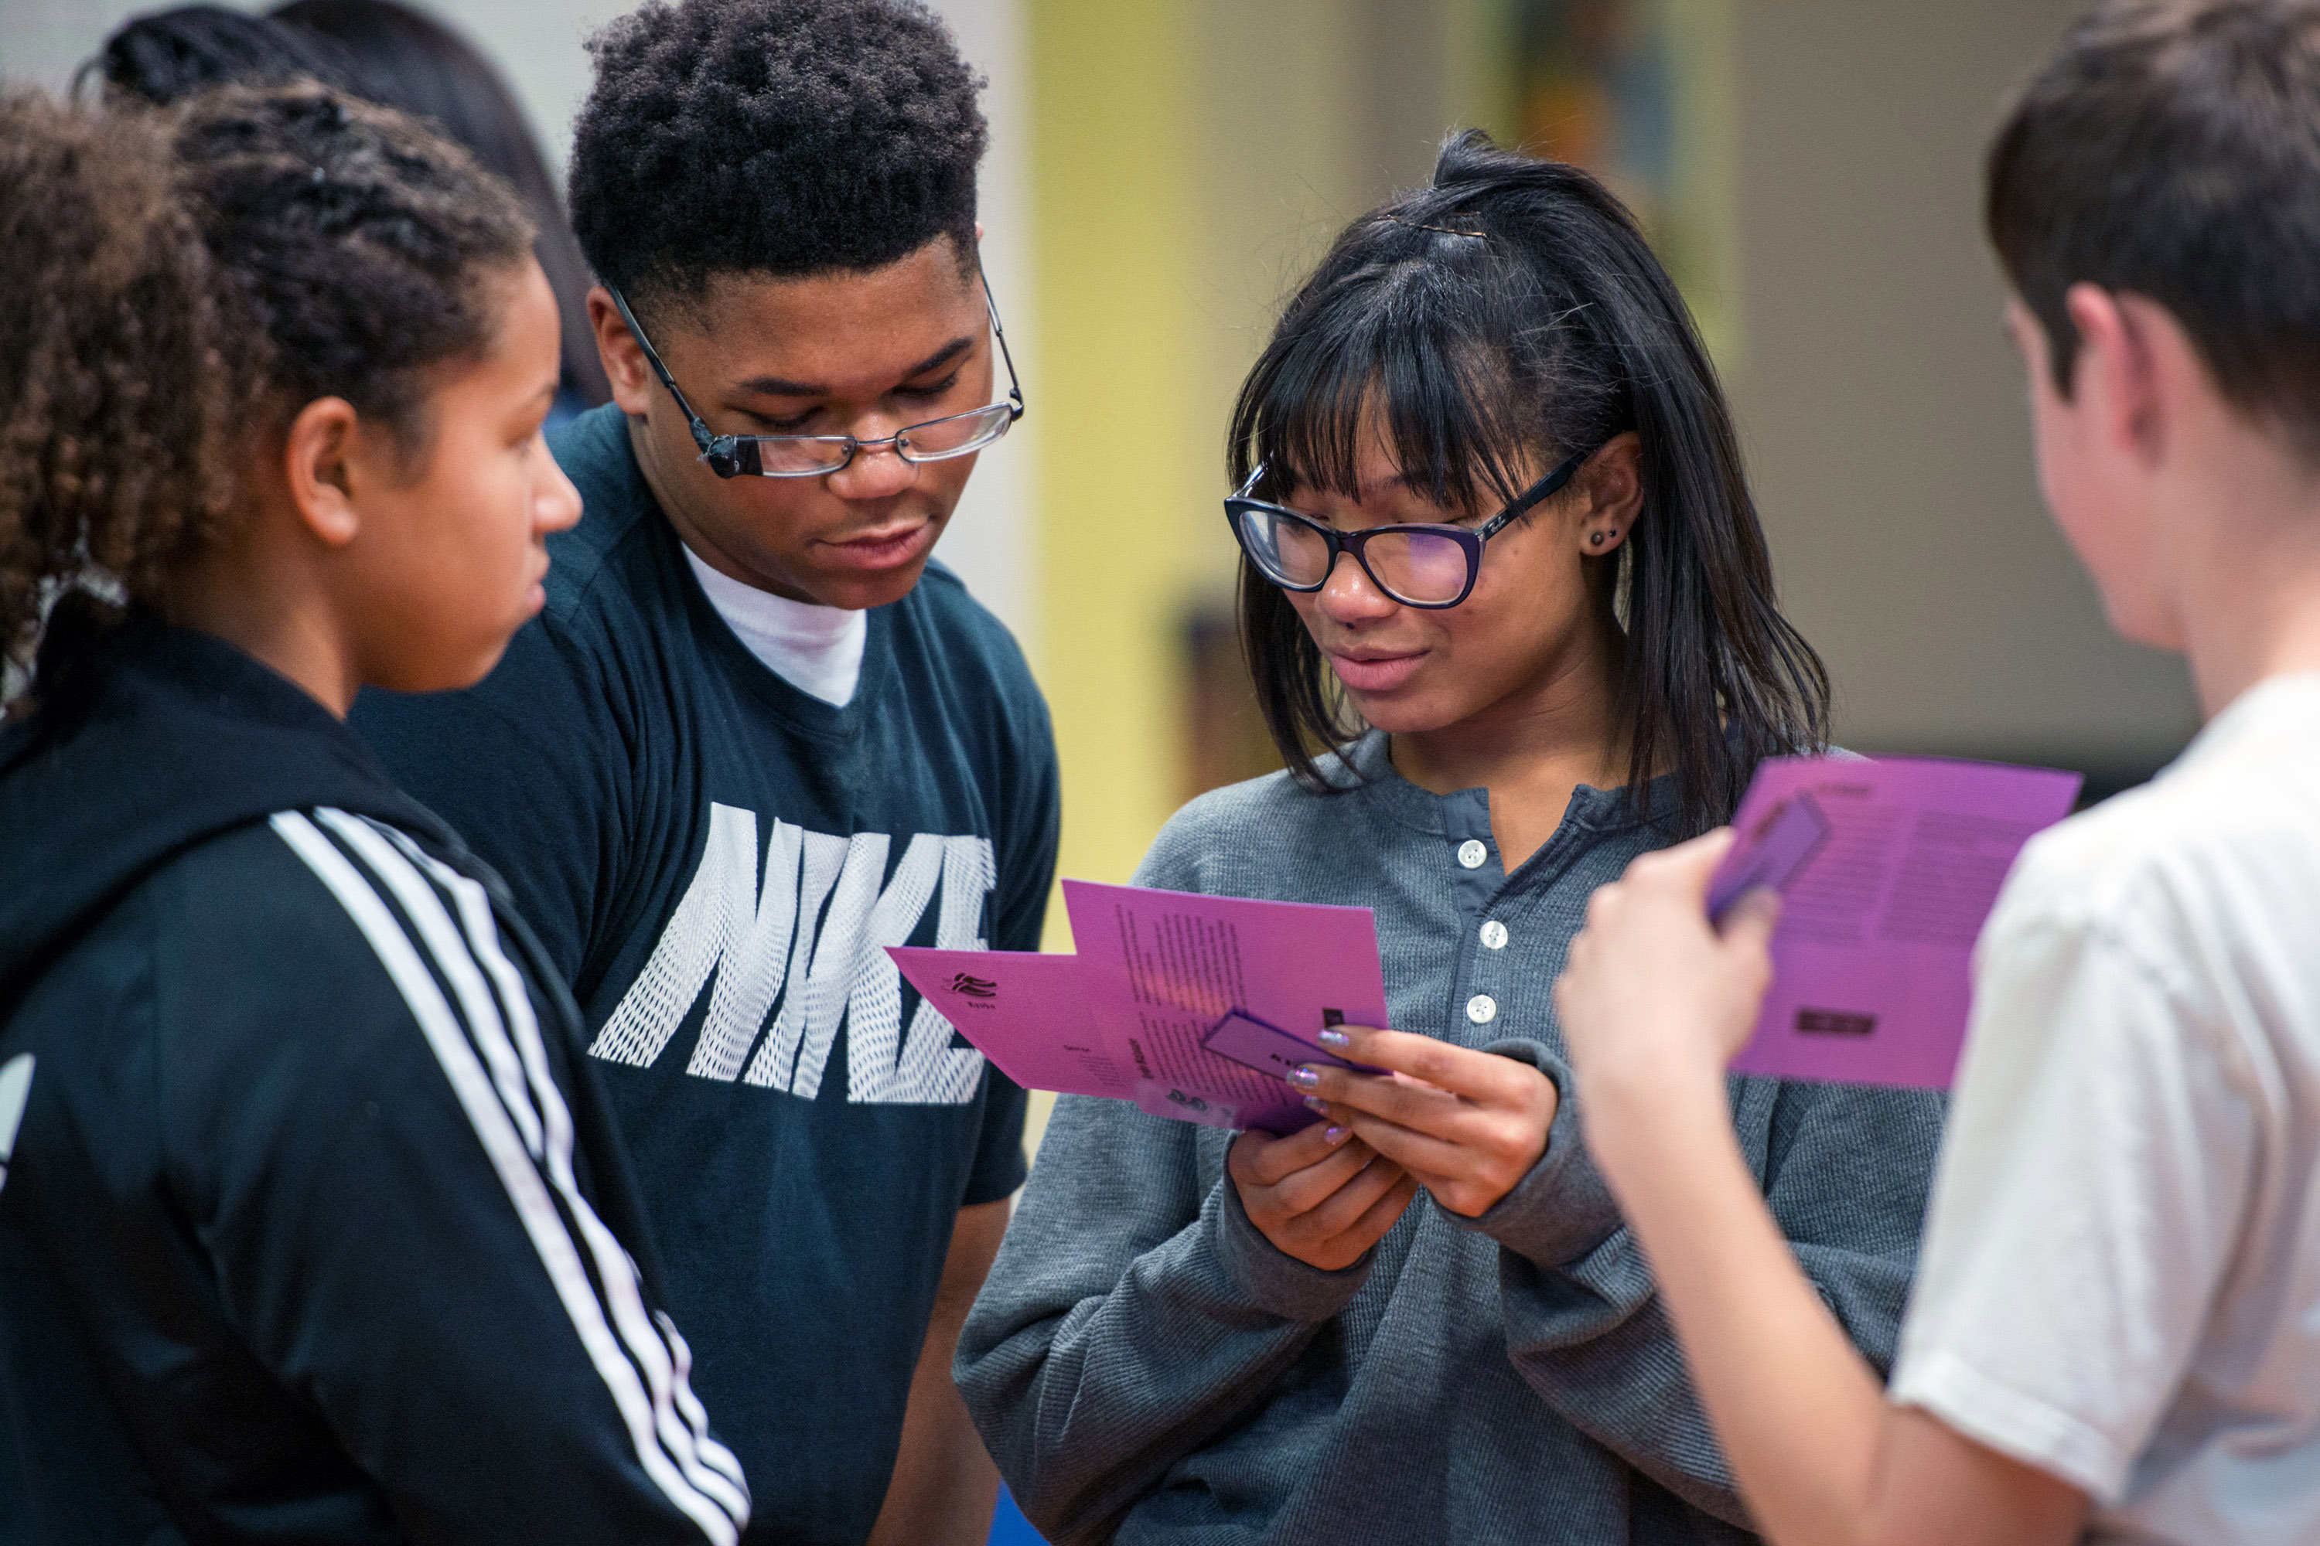
Expectations for Success
Arrive on time for day of testing
Have laptops fully charged
Bring laptop charger
Awake and ready to be ON POINT
Be in school each and every day on time for each and every class
In class, participate, ask questions, answer questions, engage in lessons
Take each questions seriously – no guessing because test is adaptive
ThePhoto by PhotoAuthor is licensed under CCYYSA.

Slide 6
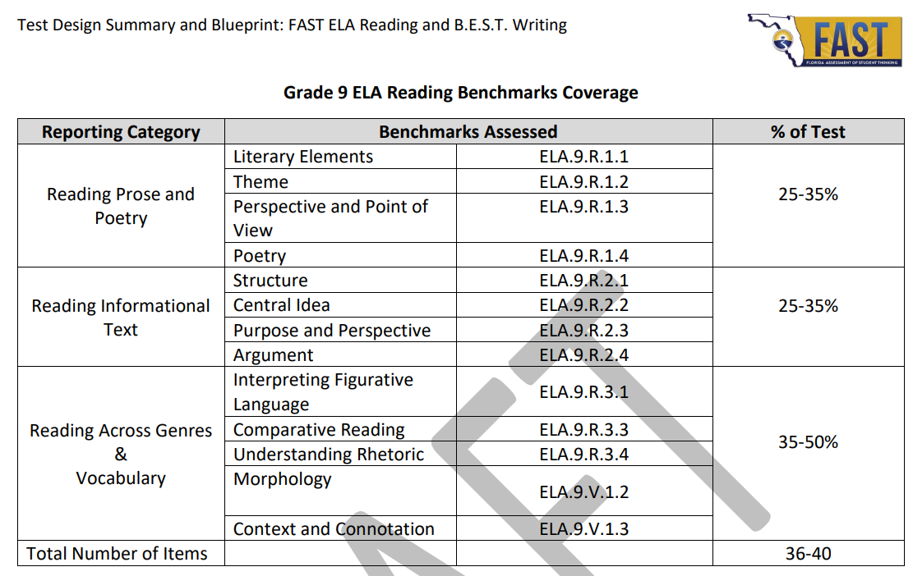
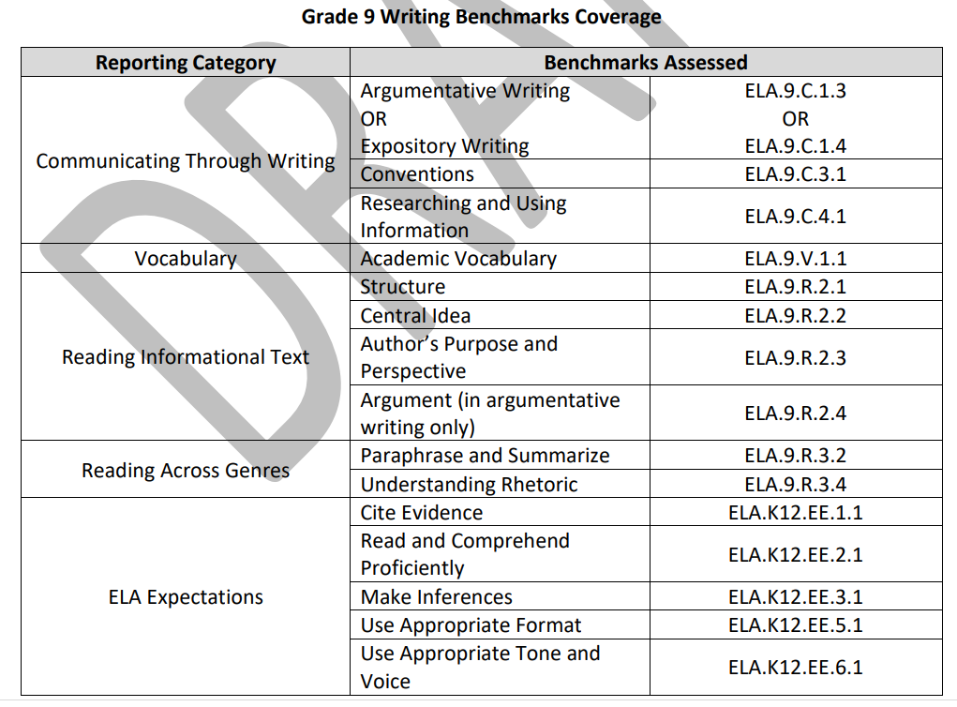
9th Grade
Test Blueprint:
Assesses Reading and Writing skills needed for school and beyond

Slide 7
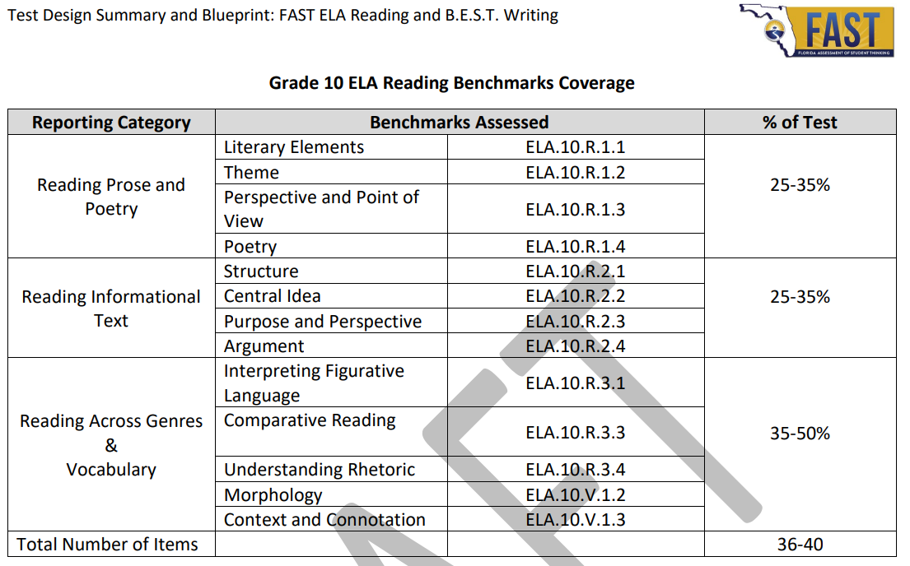
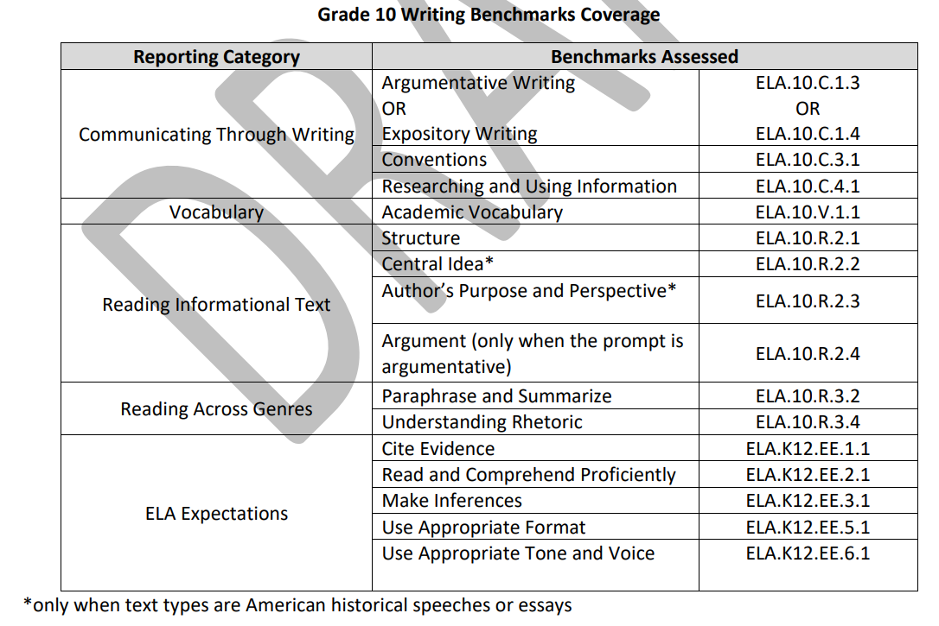
10th Grade
Test Blueprint:
Assesses Reading and Writing skills needed for school and beyond

Slide 8
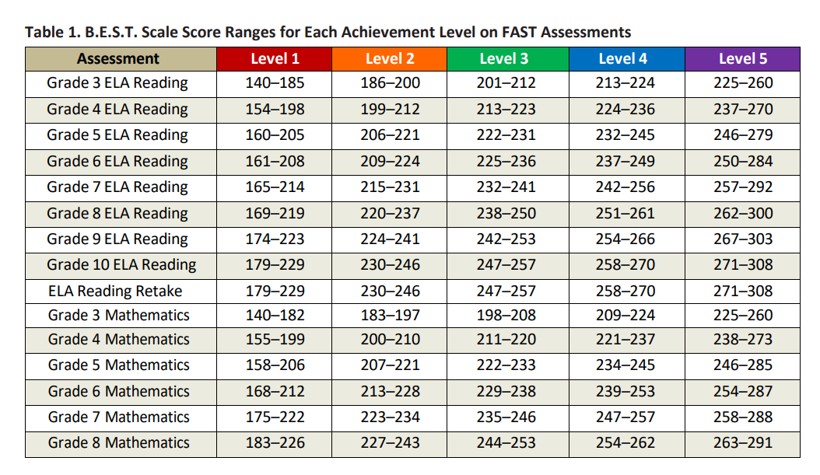
Score ranges
\

Slide 9
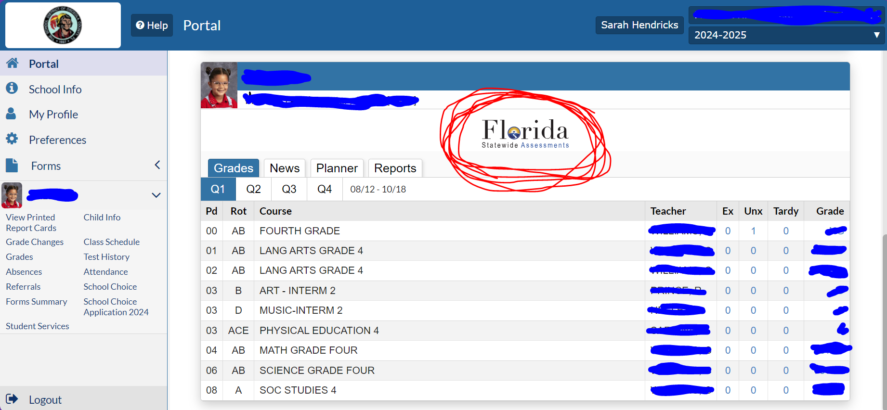
Where do I access my students FAST scores?
1.) Log into your focus parent portal or have your student log into his or her focus portal
2.) Click Florida Statewide Assessments

Slide 10
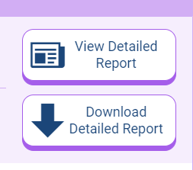
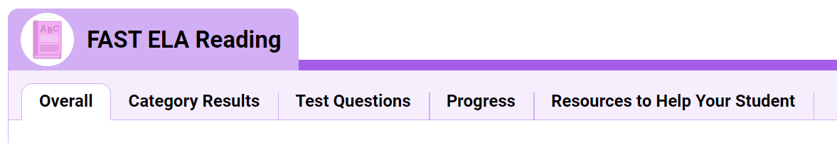
Once in the statewide assessment portal……
You will see both math and reading test reports by years
1.)Click the View detailed report button
2.) then click Resources to help your student

Slide 11
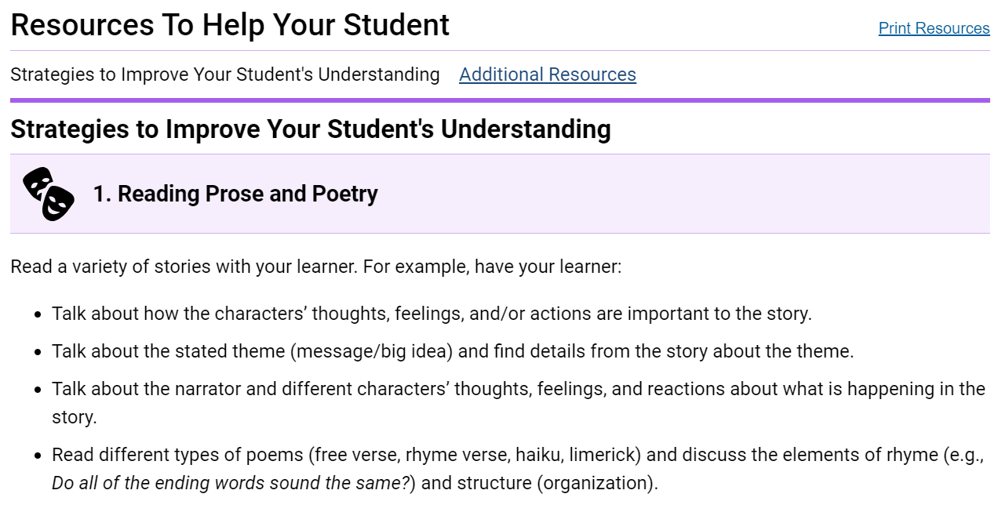
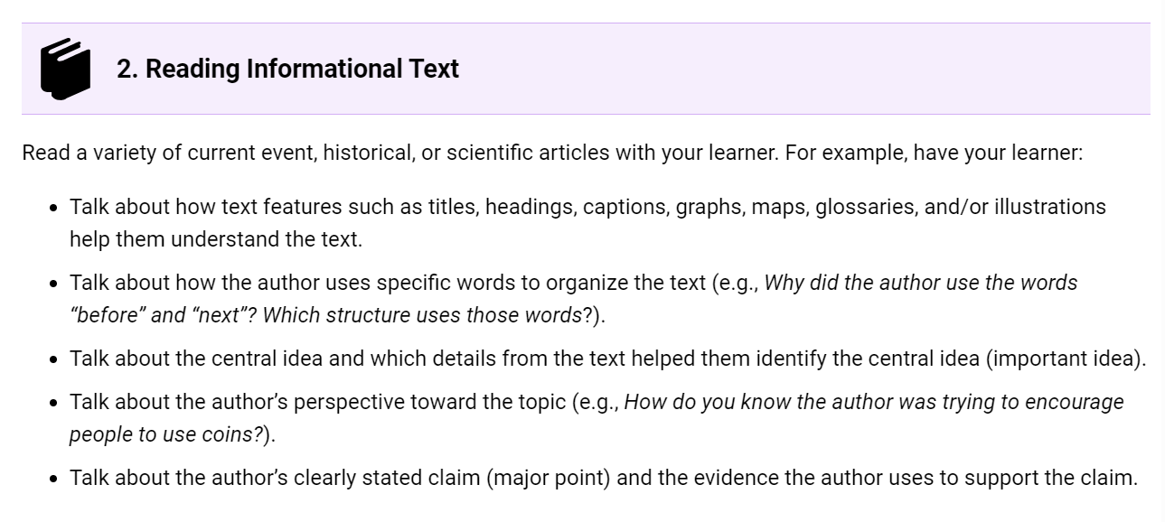
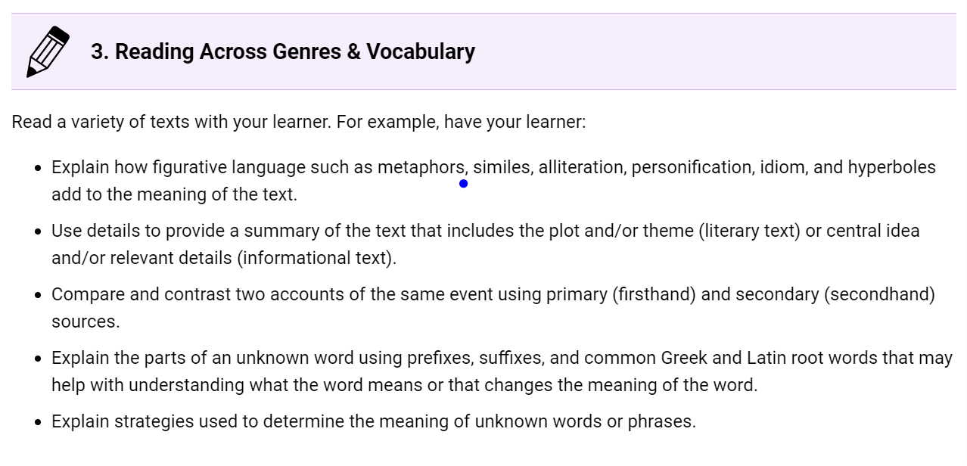
What does the parent resource look like?

Slide 12
How are we, at phs, helping your student?
Teachers have met for entire day to go over last year and current PM1 Data
Teachers and academic coach have identified individual student needs
Teachers have / will meet with students about their data and where they are in their learning (includes goal setting)
Teachers meet weekly together to plan highly impactful lessons using approved district resources
Teachers implement differentiated instruction to meet the needs of all learners: red, yellow, green / standards progression charts
After school tutoring will be available Tuesdays and Thursdays with high qualified teachers

Slide 13
Tutoring Info (Flyer coming out soon)
Tuesday
-Vila Fuentes (ENG)
-Cruz (ENG)
-Franco (ENG)
-Afanador (Reading)
-Melendez (ENG)
-Baez (Reading)
-Hernandez (Reading)
-Colon Caraballo(Reading)
-Hendricks (Reading or ENG)
Thursday
-Vila Fuentes (ENG)
-Cruz (ENG)
-Franco (ENG)
-Afanador (Reading)
-Hernandez (Reading)
-Colon Caraballo (Reading)
-Hendricks (Reading or ENG)

Slide 14
What do we need from your student for them to be successful?
Present daily (physically and mentally)
Be prepared with laptops charged, books, paper, writing utensils
Participate in class
Willing to take academic risks
Know their own data to set goals and then track them: take this process seriously
Be able to self-regulate and know their own limits
Ask for help when needed
Get excited for their future: see the connection between building reading & writing skills now and success in the future

Slide 15
What we need from you
Be present with your students' academic goals and ask daily how they are doing in achieving them (ask for specifics……what are you working on in English class? What was the most important part of the lesson today? What was something you struggled with in the lesson? Did you ask for help?)
Know how to access the focus parent portal: need help? Reach out to Angie.Reyes@osceolaschools.net or Gretchen.DiazRosario@osceolaschools.net
Know how to access your students FAST scores and the resources the statewide assessments portal offers
Make every effort to allow your student to attend tutoring

Slide 16
Thank
You
Any question or concerns you can reach me at:
Sarah Hendricks
Literacy coach
Sarah.Hendricks@osceolaschools.net

